Slide 1

Being accessible with .Net tools

Slide 2

Big Picture
We will talk about what being accessible means for web applications
We will talk about specific techniques using .Net
We will talk about specific techniques using Telerik tools
We will have Dawn ‘splain the details of our changes

Slide 3

What is accessible?
We need to make sure our sites work for everyone
Visual
Blindness, low vision, color-blindness
Hearing
Deafness
Motor
Inability to use a mouse, slow response time, limited fine motor control
Cognitive
Learning disabilities, distractibility, inability to remember or focus on large amounts of information

Slide 4
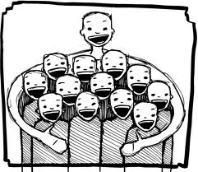
Keeping everyone in mind
http://webaim.org/intro/
http://www.w3.org/
More information
Trust but verify
WAVE plugin checker

Slide 5

.NET Techniques
http://msdn.microsoft.com/en-us/library/ms228004(v=vs.80).aspx
Easy to accomplish
Provide a way to specify a text equivalent for any non-text element.
Do not have color dependencies.
Render captions and table column headers with tables.
Associate labels with controls.

Slide 6

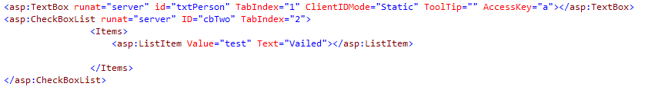
Keyboard access
Tab order with TabIndex property
All form elements have this property
Also can be set on panels
AccessKey property
Need to make discoverable via directions
Don’t conflict with know keys

Slide 7




Default elements
Every form and panel can set default submit button
Default focus set in form tag
Problem-most forms are in the master page
Solution-set property in master page

Slide 8


Set focus
Use setFocus after autopostback or Ajax call
Remember setfocus is part of script manager
Once again if master page, set property

Slide 9
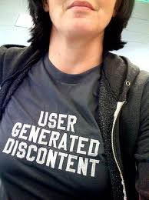
Labels and their discontents
AssociatedControl for web server controls
Takes client id
Try to make more robust with strong type
Label html tag
Use for to get client id
ClientIDMode usually needs to be set with Static

Slide 10

Telerik Labels
Most Telerik web elements have label control also
Sadly, the RadEditor is not one of them :<
Sometimes can be hard to match style
Telerik <%# clientid%> needs to be within radscriptmanager

Slide 11

Monkey see, monkey alt
Images need alt tags
Try to make unique
GenerateEmptyAlternateText to true for unimportant images
What about complex controls like trees, menus,etc.?
Tooltips act like alt images

Slide 12
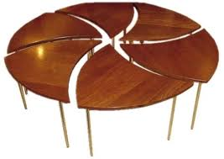
Tables and their discontent
Need theads for accessibility
Most multiple item lists don’t do this when they render table
Try to not use RepeatLayout=Table
ASP Controls
Checkboxlist
Radiobuttonlist
Note- labels will create orphan

Slide 13

Aria support for rich controls
Lots of rich controls are tabley
Lots of Telerik controls make their controls accessible with EnableAriaSupport
Controls
Calendar
RadEditor
RadComboBox
RadGrid
RadNotification
RadWindow
AccessibleRadEditor

Slide 14

Problem Children
No Aria support but should have it
RadTabStrip
RadMenu
Can’t associate labels with RadEditor
Actually a rendered iframe
Don’t use a label
http://www.telerik.com/products/aspnet-ajax/getting-started/tech-sheets/accessibility-support.aspx

Slide 15


True Grid
Alt text does not seem to do what is expected
Tooltip in grid seems to pass WAVE test
Pager dropdown seems to not be accessible

Slide 16
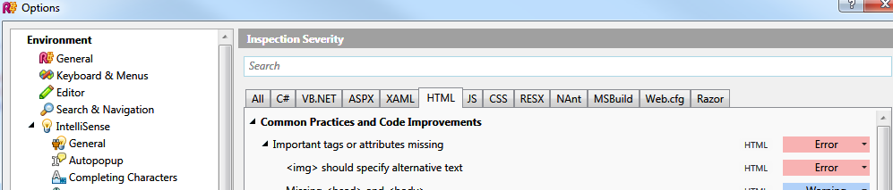

Checklists
http://www.w3.org/TR/WCAG10/full-checklist.html
Give form elements
Labels
TabIndex
Images have alt tags
Use ARIA capabilities if possible
Beware of using color for meaning
Use WAVE to find basic errors

Slide 17

A little more confusing
Render fieldset and legend elements that have div elements.
Do not require style sheets.
Support positioning using style properties.
Generate client script that is device-independent; for example, script that does not respond only to mouse clicks.

